Slide 1
Restaurant Review System
By-Apple of Discord
Date- 12/03/2021
Yash Pattani, Kai Yu, Shivakumar Vastrad and Radiah Tahsin Tanisha

Slide 2
Background
Users of the restaurant review system include restaurant managers and customers. The Review system provies a platform for the customers to share their feedback and look up for new and intresting places to eat in and around College Park, MD. While provding the restaurants with data on what is working and what is not.
Tables:-
Restaurant- Contains data about all the restaurants in the database
Customer- Contains data about all the customers in the database
Menu-Contains data about menu items in the database
Food- Contains data about the food items in the database
Rating-Contains data about the Rates relation

Slide 3
Mission Statement
Apple of Discord. inc is a restaurant rating platform; to connect restaurants and customers in and
around College Park, Maryland. We provide a seamless and intuitive method to connect people of all
ages to the food of their interest. In turn, creating a feedback loop for restaurants to understand their
customers and the general food preferences in the area.

Slide 4
Mission Objective
Have robust rating platform
Provide filtering options to customers
Provide a platform for customer feedback
Provide insights to the restaurant on the general eating habits of the sample population

Slide 5
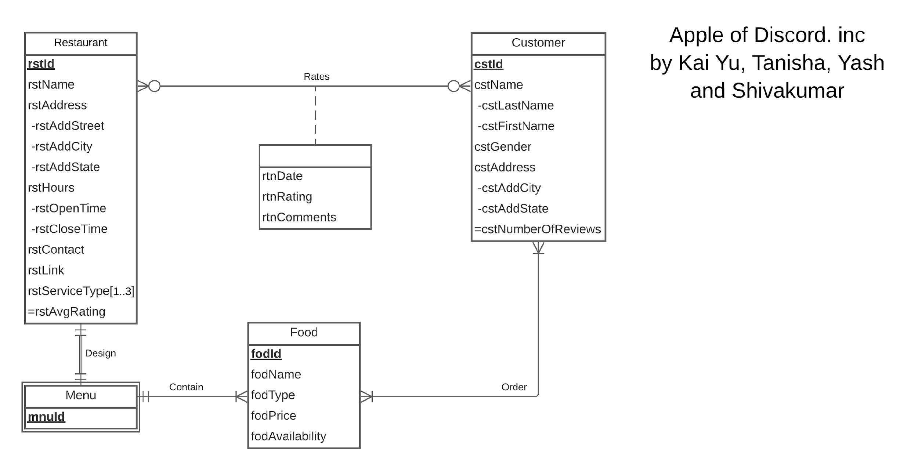
ER Diagram

Slide 6
Relational Schema
Restaurant ( rstId, rstName, rstAddress, -rstAddStreet, -rstAddCity, -rstAddState, rstHours, -rstOpenTime, -restCloseTime, rstContact, rstLink, rstServiceType[1..3], =rstAvgRating, mnuId)
Customer( cstId, cstName, -cstLastName, -cstFirstName, cstGender, cstAddress, -cstAddCity, -cstAddState, =cstNumberOfReviews)
Menu(mnuId, rtnId)
Food (fodId, fodName, fodType, fodPrice, fodAvailability, mnuId)

Slide 7
Create Table Restaurants
CREATE TABLE [AOD.Food](
fodId VARCHAR(3) NOT NULL,
fodName VARCHAR(30),
fodType VARCHAR(20),
fodPrice FLOAT(10),
fodAvailability VARCHAR(15),
mnuId VARCHAR(3)
CONSTRAINT pk_Food_fodId PRIMARY KEY(fodId))
ALTER TABLE [AOD.Food]
ADD CONSTRAINT fk_Food_mnuId FOREIGN KEY (mnuId)
REFERENCES [AOD.Menu] (mnuId)
ON DELETE NO ACTION ON UPDATE No ACTION

Slide 8
What are the items on the menu of all restaurants and their food type and prices?
GO
CREATE VIEW [Restaurant_and_Food_Price] AS
SELECT r.rstName, f.fodType, f.fodName, f.fodPrice
FROM [AOD.Restaurant] r, [AOD.Food] f
WHERE r.mnuId IN(
SELECT f.mnuId
FROM [AOD.Food]
WHERE f.mnuId = r.mnuId)

Slide 9
List all Japanese restaurant with Rating of 3 and above in and around College Park and their food details.
GO
CREATE VIEW [Japanese_Restaurant_Food_Details_With_Rating] AS
SELECT r.rstName, f.fodType, f.fodName, f.fodPrice
FROM [AOD.Restaurant] r, [AOD.Food] f
WHERE r.mnuId IN(
SELECT f.mnuId
FROM [AOD.Food]
WHERE (f.mnuId = r.mnuId) AND (f.fodType) = 'JAPANESE')
AND r.rstAvgRating >= '3'

